Slide 1
Chapter 3: LINKED LIST

Slide 2
LINKED LIST
Definition
A linked list is a linear data structure where elements are stored in nodes, and each node contains a reference (or link) to the next node in the sequence. This structure allows for efficient insertion and deletion of elements at any position within the list
In a linked list, each node typically consists of two main parts:
Data: This part holds the actual value or payload that the node is intended to store. It could be any type of data depending on the application, such as integers, strings, objects, etc.
Pointer (or Link): This part contains a reference or link to the next node in the sequence.

Slide 3
Types of linked list
1. Singly Linked List:
Each node contains data and a pointer to the next node in the sequence. Traversal is forward-only from the head (start) to the tail (end).
Memory-efficient for insertions and deletions at the head, but accessing elements by index requires linear traversal.

Slide 4
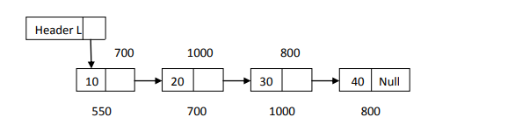
Graphically

Slide 5
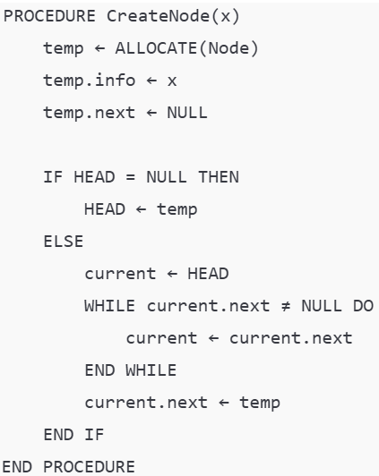
Algorithm in Single Linked List
Creating and read an element in a NODE
Temp: Temporary pointer used to create and initialize a new node.
Current: Pointer used to traverse the list.

Slide 6
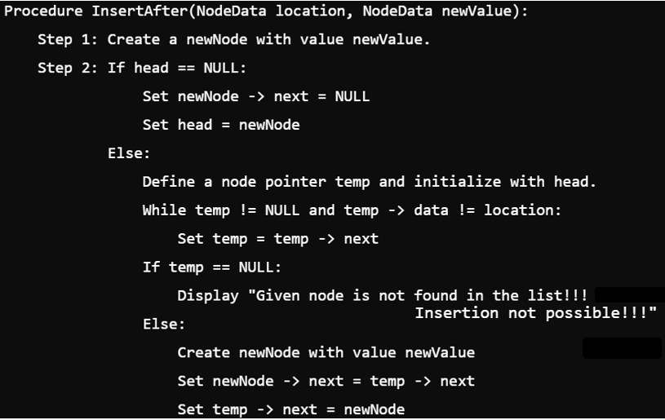
Algorithm in Single Linked List…
Inserting at Specific location in the list (After a Node)

Slide 7
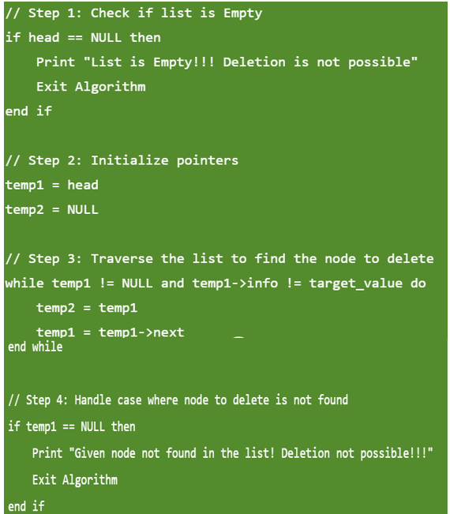
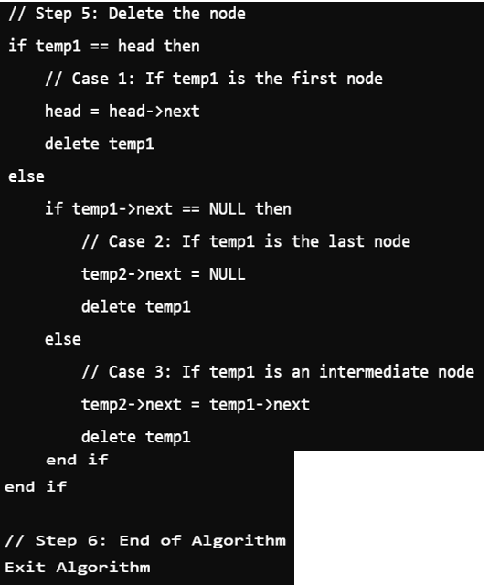
Deleting a Specific Node from the list

Slide 8
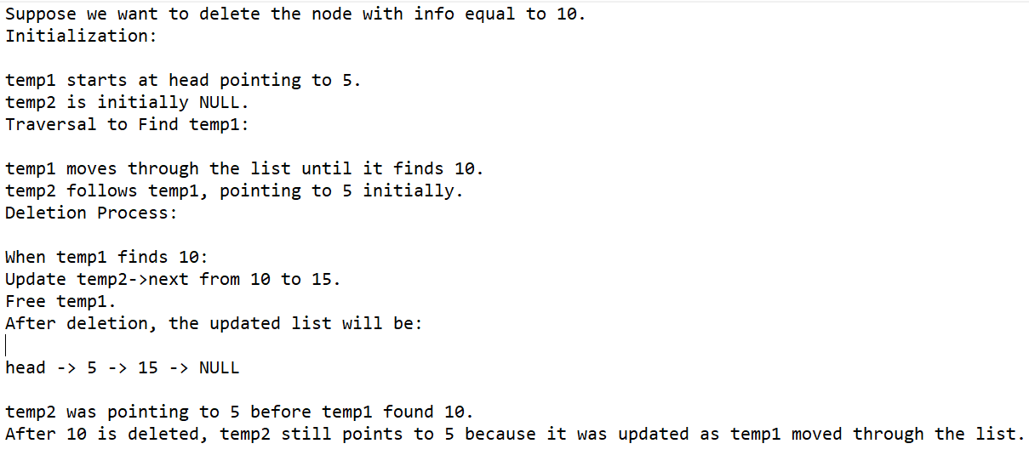
Example
Given the linked list:
head -> 5 -> 10 -> 15 -> NULL

Slide 9
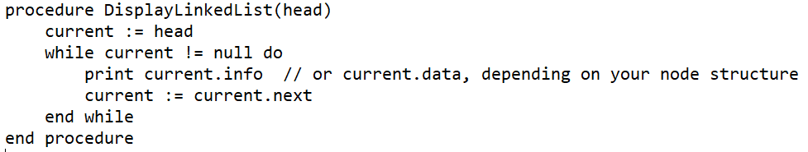
Displaying a Single Linked List

Slide 10
Types of linked list …
2. Doubly Linked List:
Each node has data, a pointer to the next node, and a pointer to the previous node.
Allows bidirectional traversal: forwards from head to tail and backwards from tail to head.
More memory-intensive due to the extra pointer per node, but allows efficient insertions and deletions at both ends and easier traversal in both directions.

Slide 11
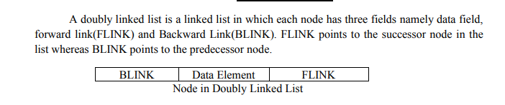

Doubly Linked List:…

Slide 12
Doubly linked list

Slide 13
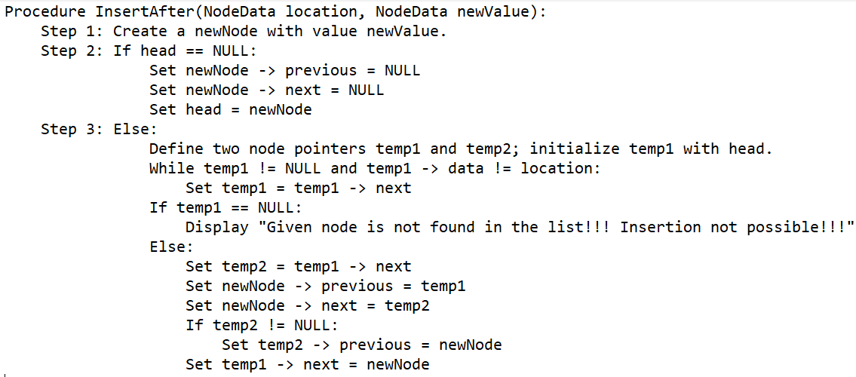
Algorithm in Doubly Linked List
Inserting at Specific location in the list (After a Node)

Slide 14
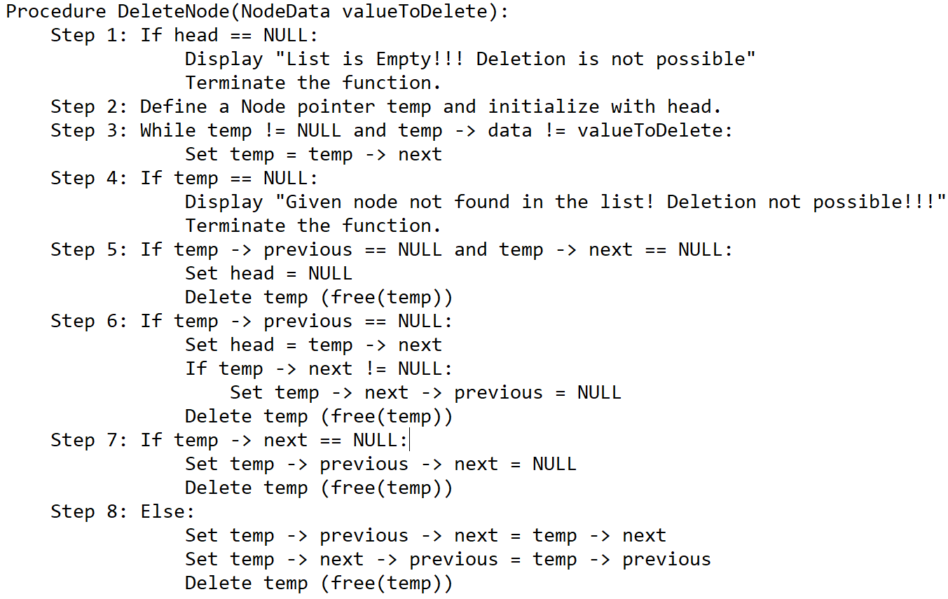
Algorithm in Doubly Linked List
Deleting a Specific Node from the list
We can use the following steps to delete a specific node from the double linked list

Slide 15
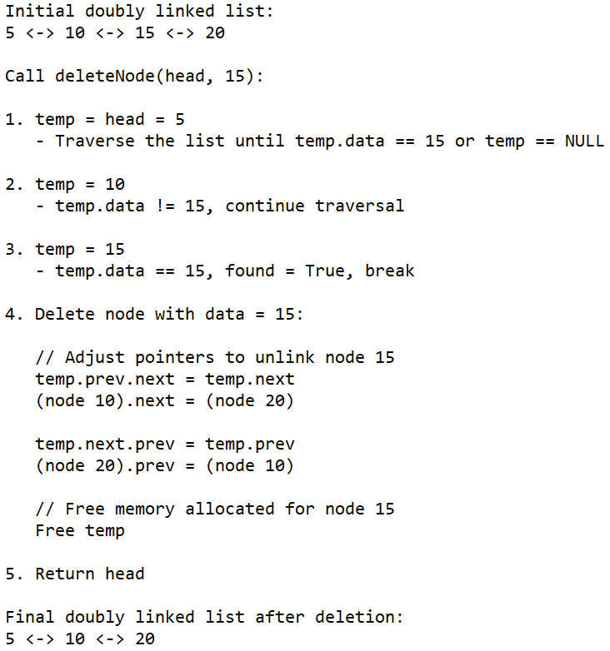
Explanation with example

Slide 16
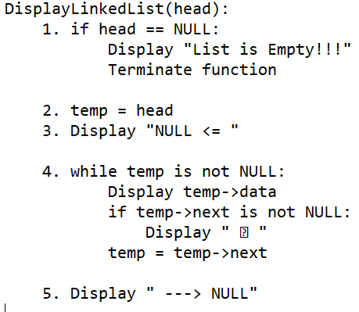
Displaying a Double Linked List
Algorithm

Slide 17
Types of linked list…
3. Circular Linked List:
Formed by connecting the last node back to the first node, creating a circular loop.
Singly or doubly linked versions exist, where traversal can start from any node and loop through the entire list back to the starting point.
Useful for applications that need continuous looping through a list or managing a circular buffer.

Slide 18
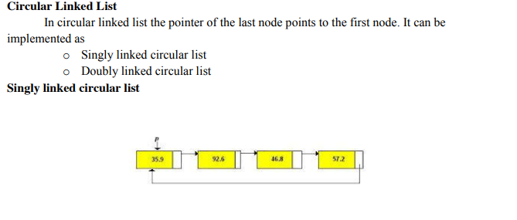
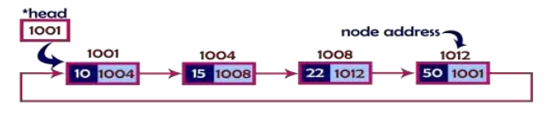
Singly Linked Circular Lists

Slide 19
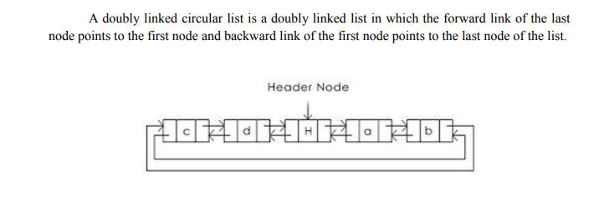
Doubly linked Circular list

Slide 20
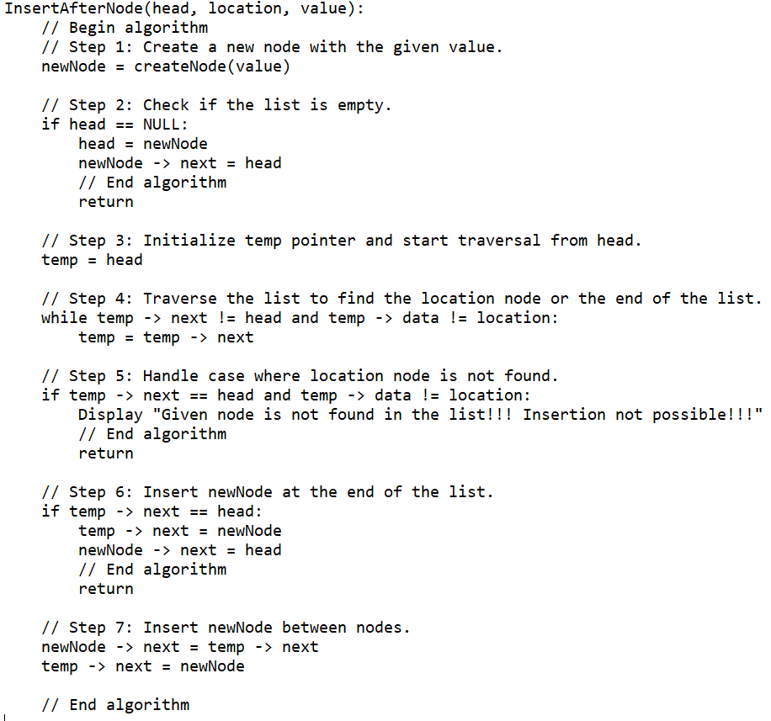
Algorithm in Circular Linked List
Inserting at Specific location in the list (After a Node)

Slide 21
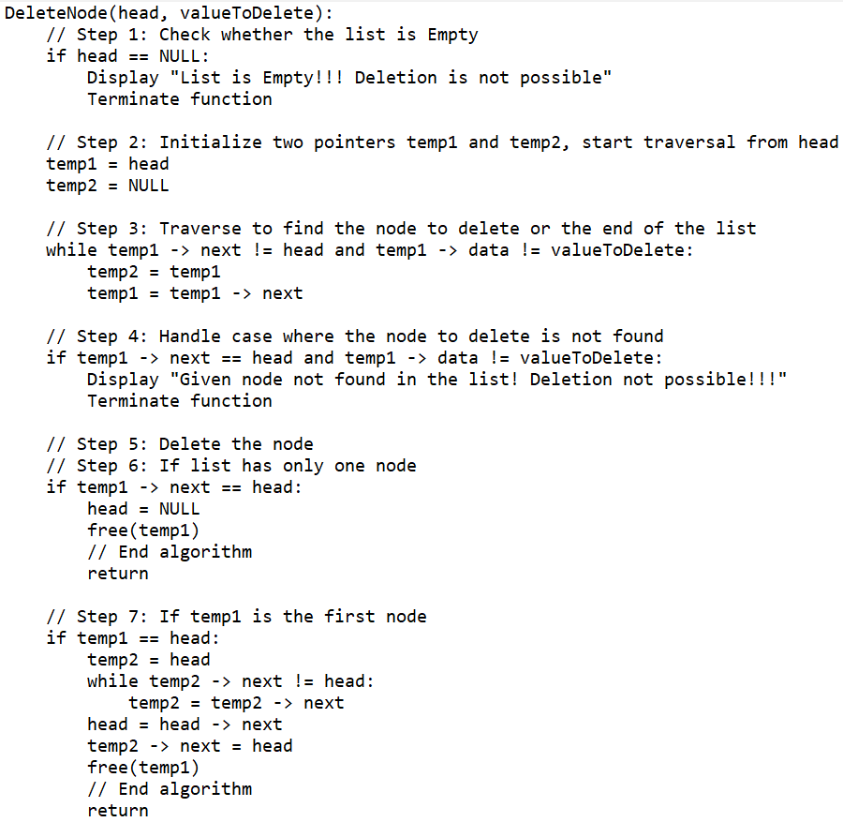
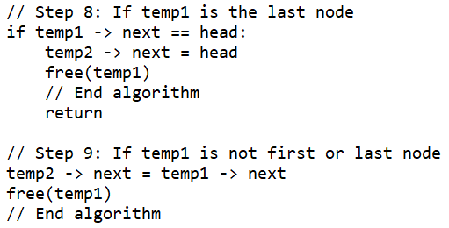
Algorithm in Circular Linked List…
Deleting a Specific Node from the list

Slide 22
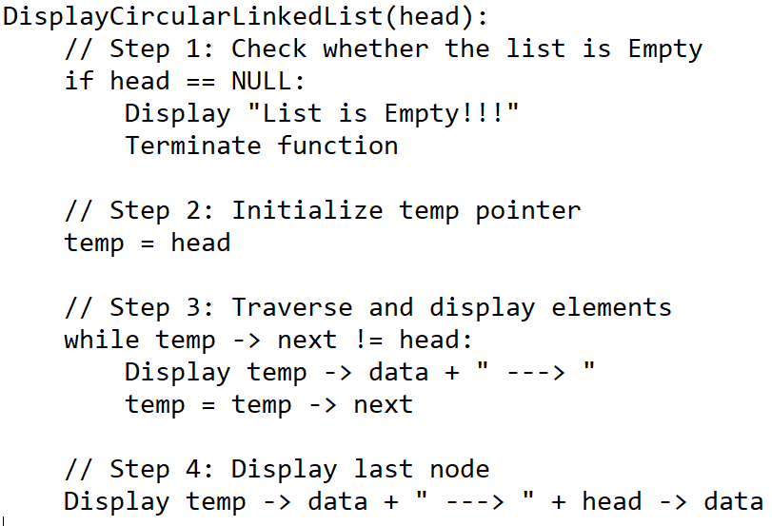
Algorithm in Circular Linked List…
Displaying a circular Linked List

Slide 23
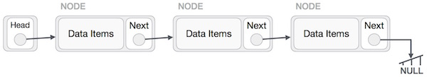
Linked List Representation(Diagrammatically)
Linked List Representation
Linked list can be visualized as a chain of nodes, where every node points to the next node.
As per the above illustration, following are the important points to be considered.
Linked List contains a node called first.
Each node carries a data field(s) and a link field called next.
Each node is linked with its next node using its next link.
Last link carries a link as null to mark the end of the list.

Slide 24
Basic Operations
Following are the basic operations supported by a list.
Insertion − Adds an element at the beginning of the list.
Deletion − Deletes an element at the beginning of the list.
Display − Displays the complete list.
Search − Searches an element using the given key.
Delete − Deletes an element using the given key.

Slide 25
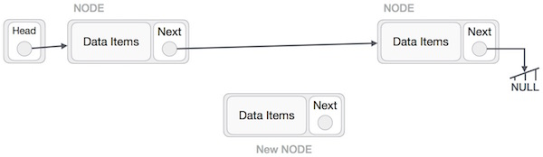
Insertion Operation
Adding a new node in linked list is a more than one step activity. We shall learn this with diagrams here. First, create a node using the same structure and find the location where it has to be inserted.
Imagine that we are inserting a node B (NewNode), between A (LeftNode) and C (RightNode). Then point B.next to C −

Slide 26
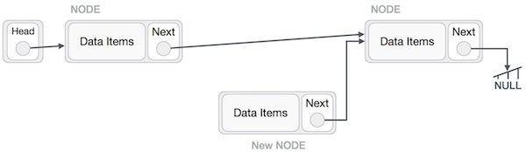
Insertion Operation
NewNode.next −> RightNode;
It should look like this −

Slide 27
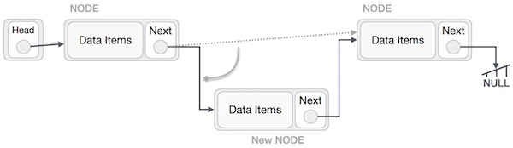
Insertion Operation
Now, the next node at the left should point to the new node.
LeftNode.next −> NewNode;

Slide 28
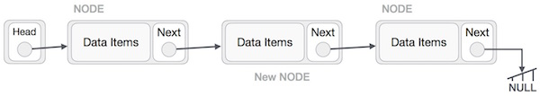
Insertion Operation
This will put the new node in the middle of the two.
The new list should look like this −

Slide 29
Insertion Operation
Similar steps should be taken if the node is being inserted at the beginning of the list. While inserting it at the end, the second last node of the list should point to the new node and the new node will point to NULL.

Slide 30
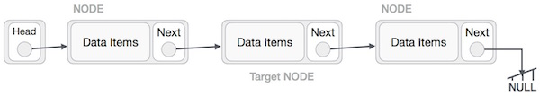
Deletion Operation
Deletion is also a more than one step process. We shall learn with pictorial representation. First, locate the target node to be removed, by using searching algorithms.

Slide 31
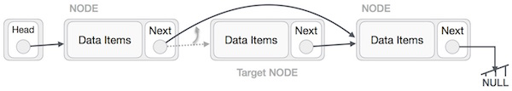
Deletion Operation
The left (previous) node of the target node now should point to the next node of the target node −
LeftNode.next −> RightNode;

Slide 32
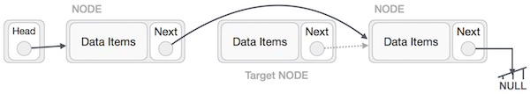
Deletion Operation
This will remove the link that was pointing to the target node. Now, using the following code, we will remove what the target node is pointing at.
RighttNode.next −> NULL;

Slide 33
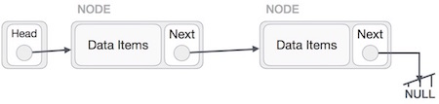
Deletion Operation
We need to use the deleted node. We can keep that in memory otherwise we can simply deallocate memory and wipe off the target node completely.

Slide 34
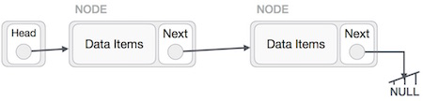
Reverse Operation
This operation is a thorough one. We need to make the last node to be pointed by the head node and reverse the whole linked list.

Slide 35
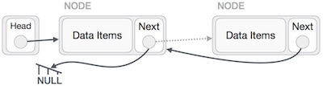
Reverse Operation
We have to make sure that the last node is not the lost node. So we'll have some temp node, which looks like the head node pointing to the last node. Now, we shall make all left side nodes point to their previous nodes one by one.

Slide 36
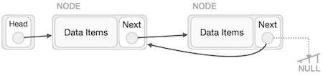
Reverse Operation
we traverse to the end of the list. It should be pointing to NULL. Now, First, we shall make it point to its previous node −

Slide 37
Reverse Operation
we traverse to the end of the list. It should be pointing to NULL. Now, First, we shall make it point to its previous node −We have to make sure that the last node is not the lost node. So we'll have some temp node, which looks like the head node pointing to the last node. Now, we shall make all left side nodes point to their previous nodes one by one.

Slide 38
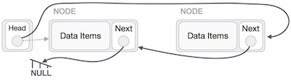
Reverse Operation
Except the node (first node) pointed by the head node, all nodes should point to their predecessor, making them their new successor. The first node will point to NULL.

Slide 39
Reverse Operation
We'll make the head node point to the new first node by using the temp node.

Slide 40
END

